Slide 1
Examining the average age of students on this course
A Bayesian updating approach

Slide 2
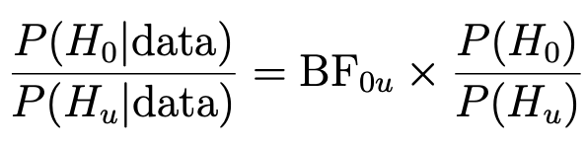
Introduction of the statistical model
Bayesian updating - the application of Bayes’ Theorem
Posterior
Prior

Slide 3
Hypothesis of interest
Hypothesis: the average age of the students in this course is 264 months

Slide 4

Using your age to reach a decision
We will use three methods:
Bayesian updating
Fixed 0.05 level at each observation
O’Brien & Fleming stopping rules
Calculate your age in months and report it back to us when asked!

Slide 5
Best Practice
Determine the size of Bayes factor.
Decide on the size of an initial batch of individuals.
Decide on the maximum number of individuals that can be obtained.
Notes:
~3

Slide 6
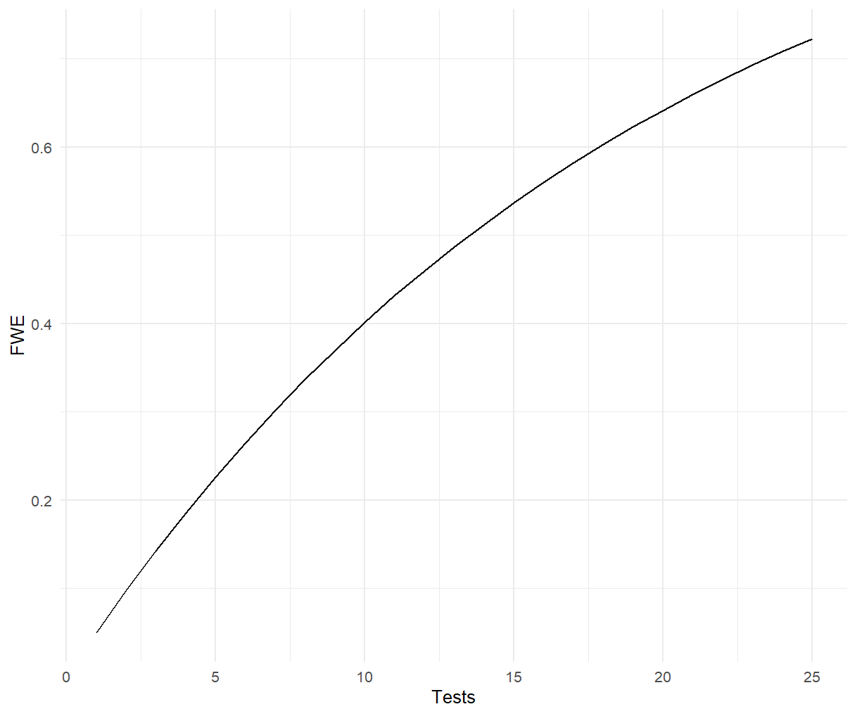

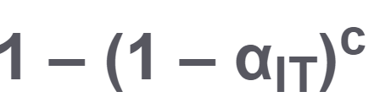
Fixed marginal alpha: Inflated overall alpha?
The familywise error rate (FWE) is the probability of a coming to at least one false conclusion in a series of hypothesis tests

Slide 7
Comparison of methods
Updating using the p-value
No evidence provided to evaluate the strength of the hypotheses
Choice of alpha at each analysis has a large influence on the decision to continue or stop at each timepoint.
Inflated familywise error rate
Updating using the Bayes factor
Evidence provided at each analysis both for the null and alternative hypotheses
Method easily extends to more hypotheses (>264 months, for instance)
Harder to make a clear stopping decision

Slide 8
Conclusion
Or is it?

Slide 9
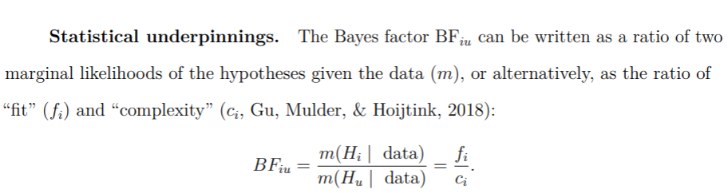
Our attempt at proving this equality

